Slide 1







Technology Trends
Angele Simard
August 21, 2024

Slide 2



OUTLINE
Executive Summary
Introduction
Methodology
Results
Visualization – Charts
Dashboard
Discussion
Findings & Implications
Conclusion
Appendix

Slide 3

EXECUTIVE SUMMARY
Identify key trends in emerging technologies, focusing on programming languages, database skills, and developer demographics
JavaScript and HTML/CSS remain the top programming languages with Python, Go and Kotlin gaining traction
MySQL is the most used database, with PostgreSQL and MongoDB rising in popularity
The data reveals a significant gender gap, with most developers being men aged 25-34
These insights highlight the need for continued emphasis on web development, modern database adoption and initiatives to promote gender diversity and global representation in the tech industry

Slide 4

INTRODUCTION
Identify trends for emerging technologies
Asking the following questions:
Which programming languages are currently most sought after?
Which database skill are highly valued in the job market?
What are the insights and trends in the gender and age distribution of developers?

Slide 5

METHODOLOGY
Data Sources:
GiTHub Jobs API
Popular Programming Languages
Stack Overflow Survey
Data Wrangling:
Finding and removing duplicate
Finding and imputing missing values
Normalizing Data(Compensation)
Exploring the Data:
Analyzing the data distribution, handing outliers, looking for correlations
Visualizing the Data
Distribution, relationships, composition and comparisons

Slide 6

RESULTS
Programming Language Trends
Database Trends
Dashboards
Current Technology Trend
Future Technology Trend
Demographics

Slide 7
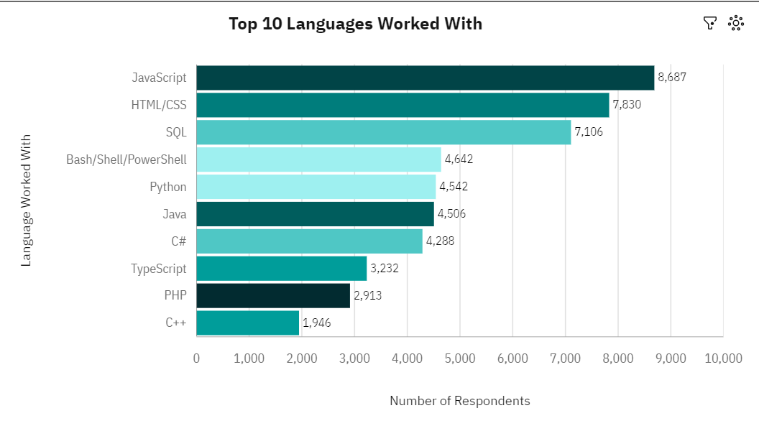
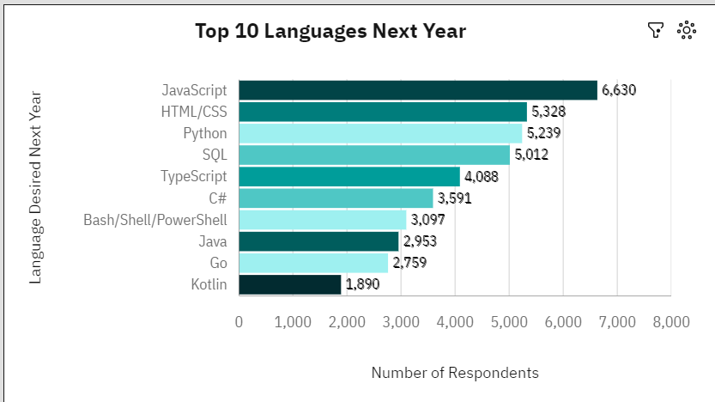
PROGRAMMING LANGUAGE TRENDS
Current Year
Next Year

Slide 8
PROGRAMMING LANGUAGE TRENDS - FINDINGS & IMPLICATIONS
Findings
JavaScript & HTML/CCS top both top programing languages currently and next year
Python is trending up from 5th to 3rd spot for next year
GO & Kotlin appear on the top 10 list for next year while C++ & PHP fall off the list
Implications
JavaScript & HTML/CSS are critical programming languages
Choosing to learn Go or Kotlin might be a strategic move for differentiation.
Companies currently using C++ and PHP might consider transitioning to more modern languages.

Slide 9
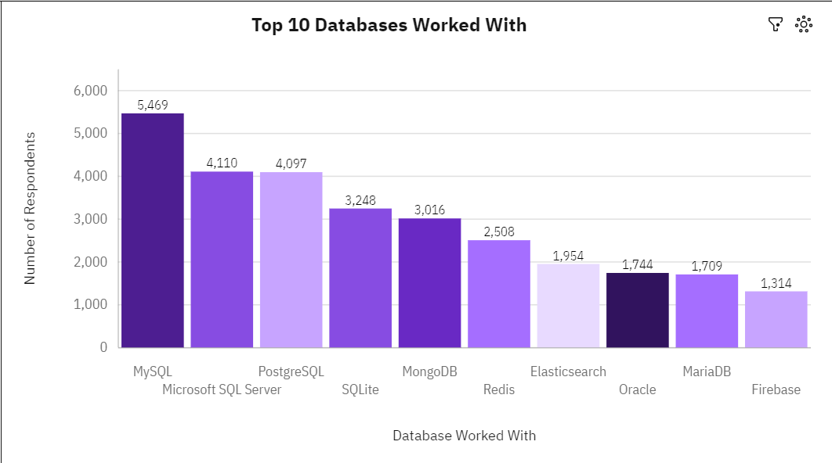
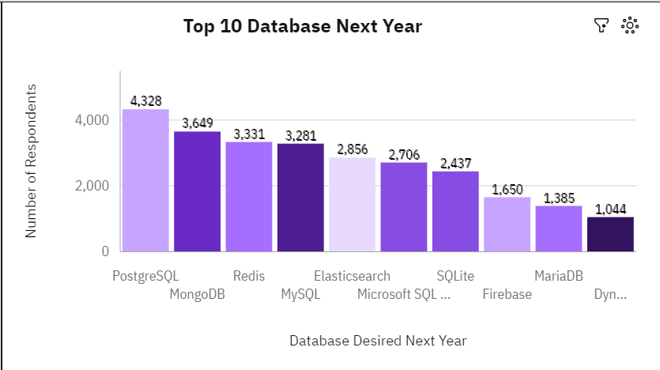
DATABASE TRENDS
Current Year
Next Year

Slide 10
DATABASE TRENDS - FINDINGS & IMPLICATIONS
Findings
MySQL is the most frequently used database
PostgreSQL tops the list for database next year
MongoDB is 5th for current year and climbs to 2nd for next year
Implications
MySQL has widespread adoption as a reliable tool
Learning PostgreSQL positions developers well in the job market
Ongoing shift toward NoSQL databases

Slide 11
DASHBOARD
https://github.com/FloraBurns1/testrepo/blob/main/Technology%20Usage%20and%20Trends.pdf

Slide 12
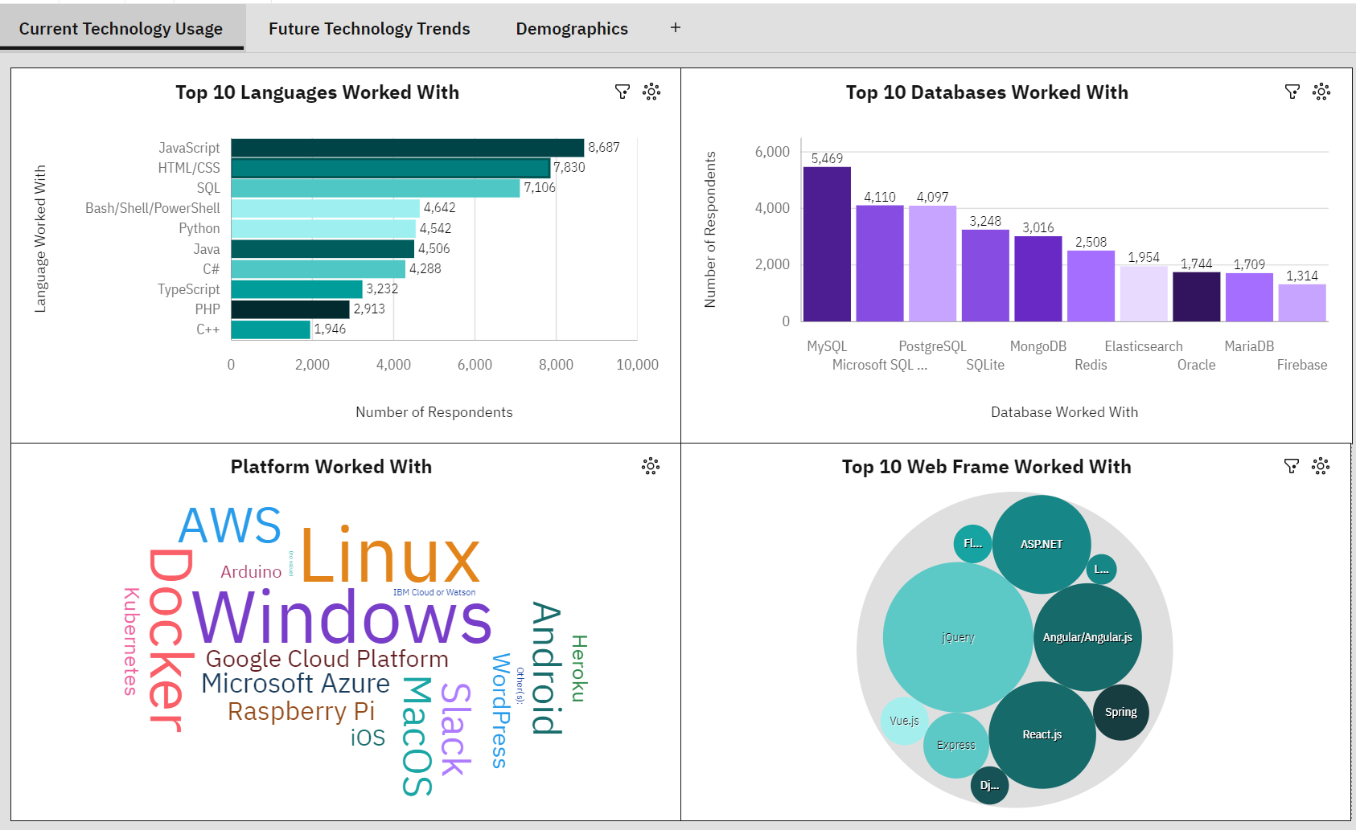
DASHBOARD TAB 1

Slide 13
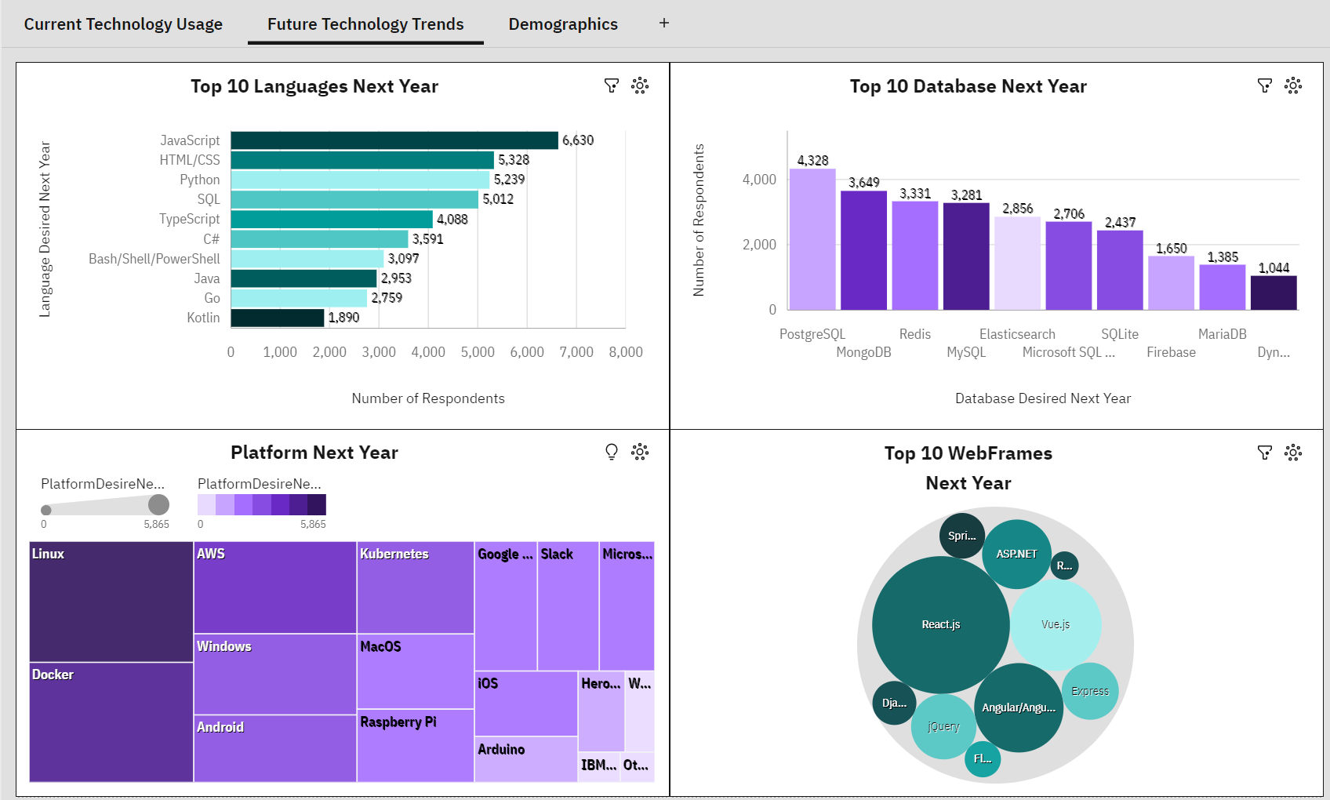
DASHBOARD TAB 2

Slide 14
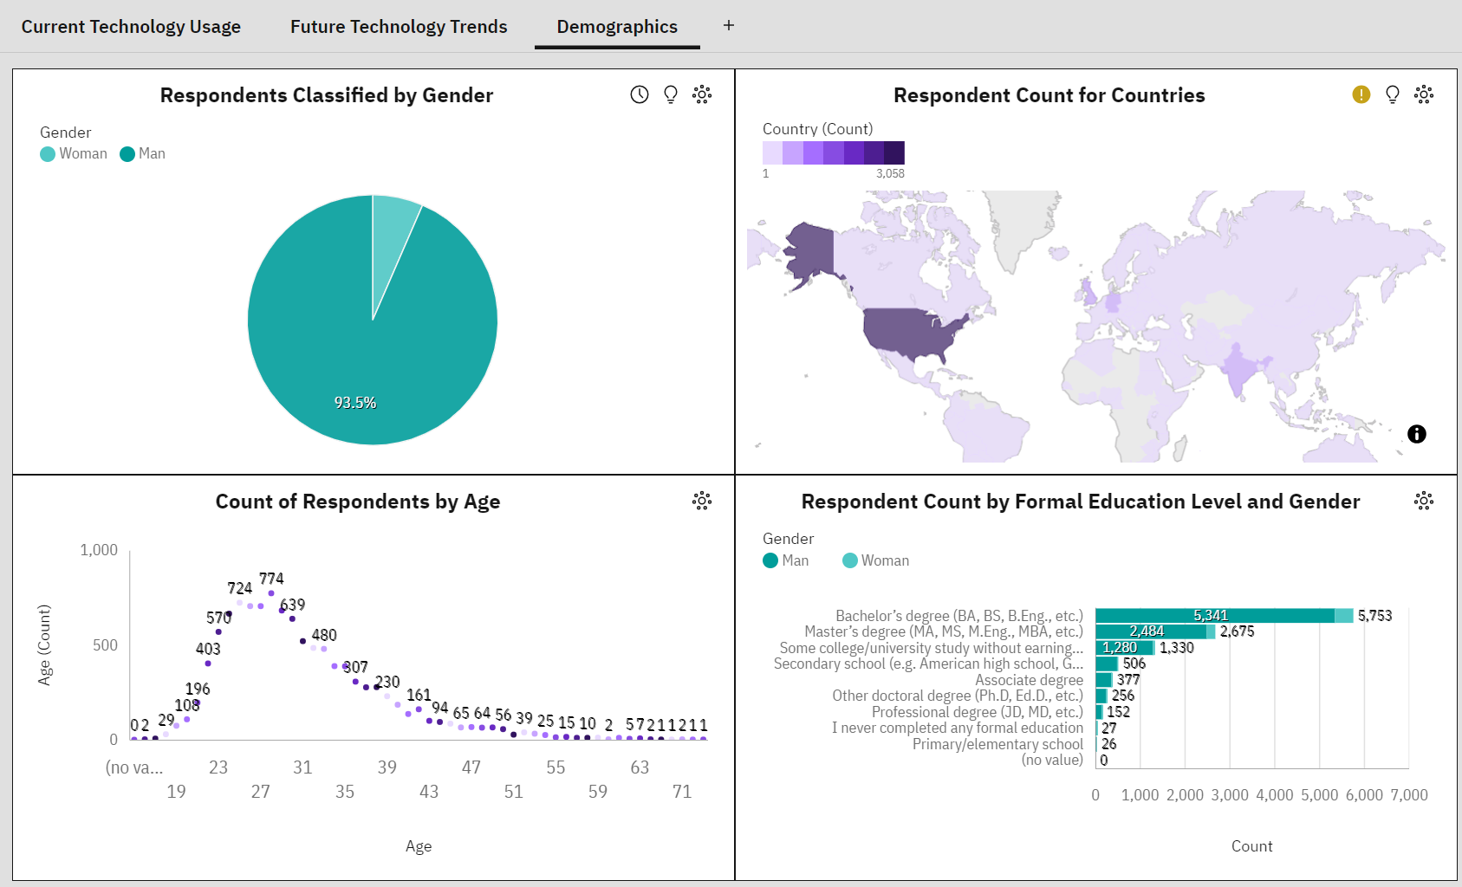
DASHBOARD TAB 3

Slide 15
DISCUSSION - Demographics
93.5 % of respondents are men
Majority of respondents are between 25 and 34 years old
Bachelor’s Degree and Master’s Degree are the top 2 categories for Education level
Skewed geographic responses from the USA, followed by India.

Slide 16
OVERALL FINDINGS & IMPLICATIONS
Findings
Top programming languages in demand: JavaScript & HTML/CSS
Top database skills in demand: My SQL with PostgreSQL and MondoDB gaining top support for next year
Gender gap favoring men in developed countries
Implications
Continued emphasis on web development with companies investing more and enhancing web applications
Indicates a shit towards modern, flexible database solutions
Need for initiatives to promote gender diversity to create a more balanced and inclusive workforce

Slide 17

CONCLUSION
Identifying the trends for emerging technologies emphasizes the need for continued focus on:
Web development
Modern database adoption
Gender diversity
Global representation
These insights and trends will drive progress and innovation in the tech industry
Companies can better position themselves for future success and create a more inclusive and dynamic technological landscape

Slide 18
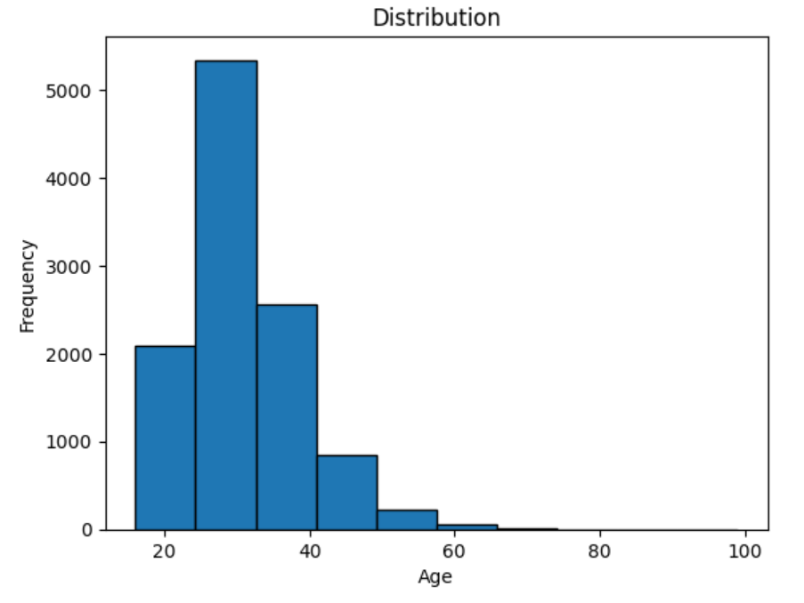
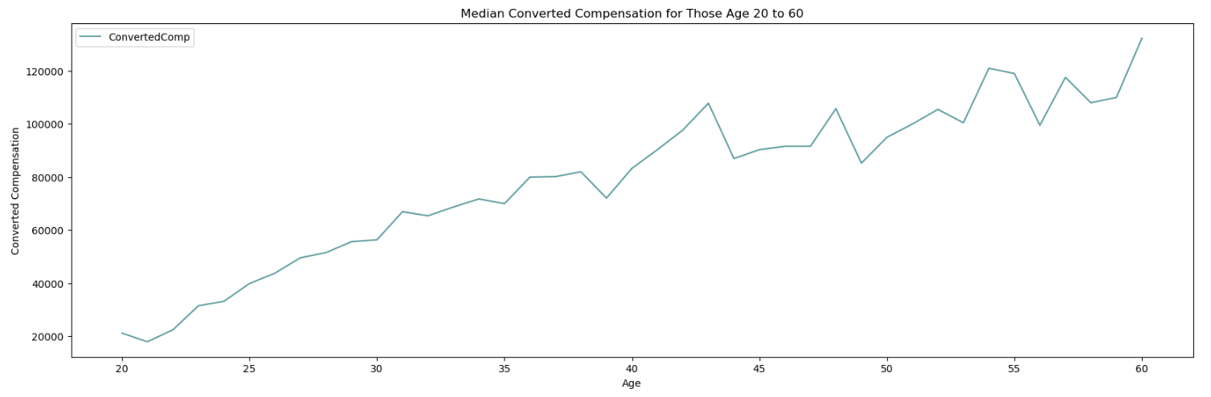
APPENDIX

Slide 19
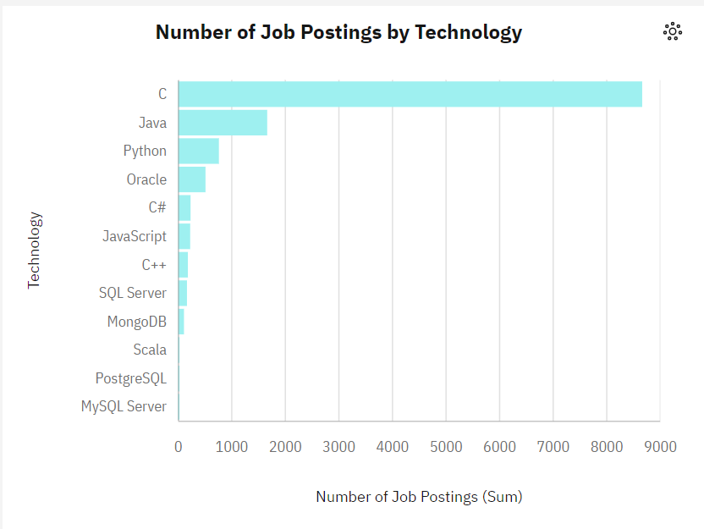
JOB POSTINGS

Slide 20
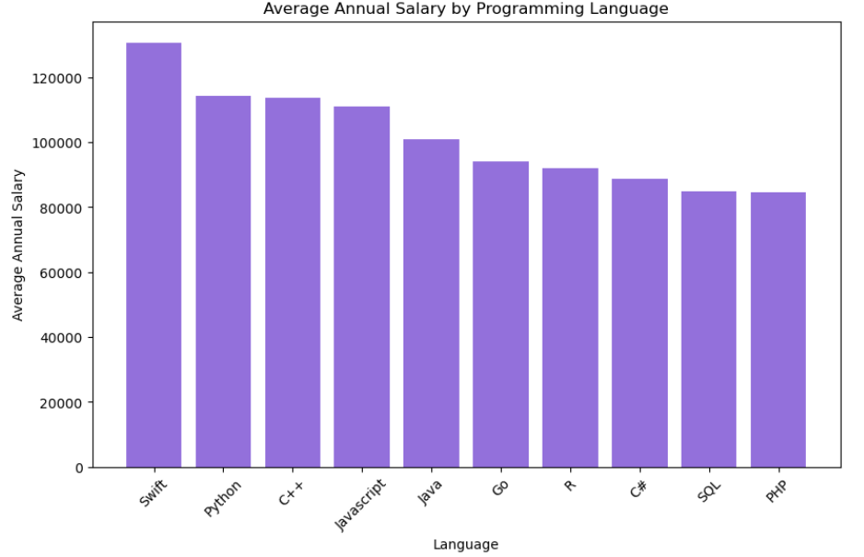
POPULAR LANGUAGES

